Slide 1
TsunamiLab
Exercise 4
Alexander Binsmaier,
Ludwig Peuckert

Slide 2
Mac Cluster
Logged in to Mac cluster
Same results
Similar execution time

Slide 3
Intel Compiler
Simulation, Chile scenario, 1000x1000 cells, 10.000s
 | gnu | Intel -02 | Intel -fast | Intel -02 -fast
Initialisation | 44s | 14s | 7s | 7s
Simulation | 80s | 66s | 64s | 61s
Vectorization: main loop not vectorized
Optimization: Solver seems to be inlined

Slide 4
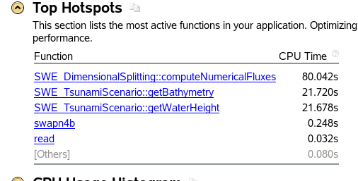
VTune
Improved: We had a method to look up the closest x/y value which searched the
array sequential. Changed to binary search => initialization times close to zero
Further: - create dictionary to store x/y values
- merge getBathymetry&WaterHeight

Slide 5
OpenMP
Added parallelization at SWE_DimensionalSplitting.hpp: computeNumericalFluxes()
Snb2 table. Chile 1000x1000, 4000s, 32 threads (snb)
 | Without | Inner loop | Outer loop
Time | 72 | 55 | 31
Speedup | 1 | 1.31 | 2.32
Speedup with 16 threads and parallelization of the outer loop is 1.2
There has been a pause shortly before the end
for about 19 seconds every single time though.
Without this interruption speedup would have been 1.72

Slide 6
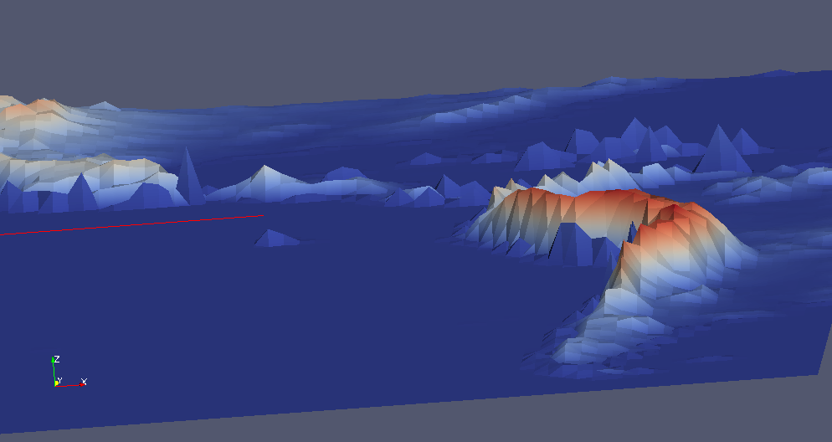
Coarse Output
Added implementation at writer.writeVarTime(in)dependent

Slide 7
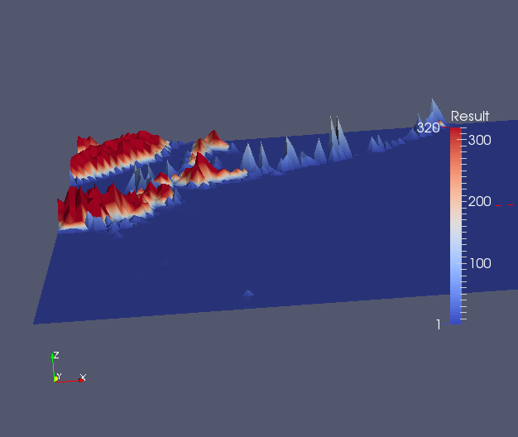

Slide 8
Dynamic Rupture Project
Current assumption:
  Displacement in bathymetry at timestep zero
  Tsunami wave initially is „like the displacement“
  This is an easy simplification to the actual origin of a tsunami

Slide 9
Dynamic Rupture Project
Goal:
  Tsunami is a consequence of a rupture
  => Create a wave by reading seismological data

Slide 10
Dynamic Rupture Project
Timeline
CW 51:
  Remove bugs!
  Get data from Mr Percy Galvez
CW 52:
  Find a way to get the data to a format usable in the simulation
  Implement a dynamic displacement reader

Slide 11
Dynamic Rupture Project
Timeline
CW 1:
  Adjust writer to write bathymetry time dependent
CW 2:
  Adjust the simulation to get possibility to change bathymetry per timestep
CW 3:
  Simulate Tohoku Scenario with this approach and highlight the most significant changes

